Slide 1
One-Class Classification Methods
Deb McCaffrey

Slide 2
Credit Card Fraud Detection Dataset
From Kaggle: link
‘Time’ and ‘Amount’ variables have been preserved
All other variables transformed with PCA
492 frauds out of 284,807 transactions
1 = fraud, 0 = legitimate
50/20/20/10 train/validate/test/update sets
Training set has no frauds

Slide 3
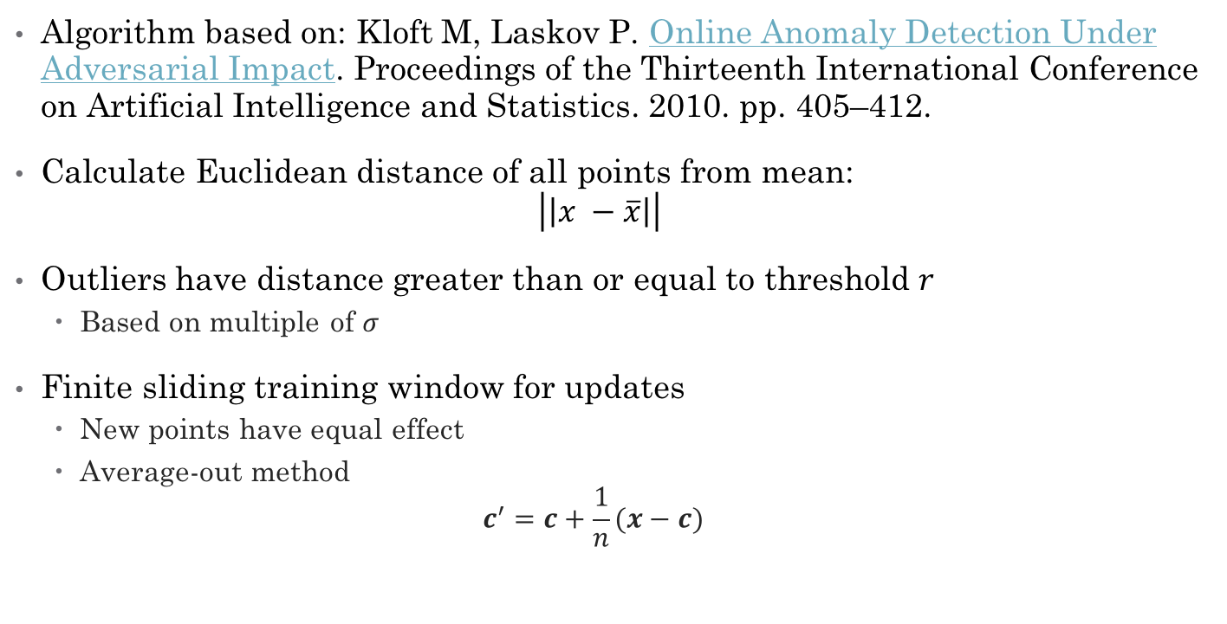
Method 1 – Centroid Anomaly Detection
Algorithm based on: Kloft M, Laskov P. Online Anomaly Detection Under Adversarial Impact. Proceedings of the Thirteenth International Conference on Artificial Intelligence and Statistics. 2010. pp. 405–412.
Calculate Euclidean distance of all points from mean: $\left|\left|x −\overline{x}\right|\right|$
Outliers have distance greater than or equal to threshold $r$
Based on multiple of $σ$
Finite sliding training window for updates
New points have equal effect
Average-out method $c^{′}=c+\frac{1}{n}(x−c)$

Slide 4
Motivation
Simple
Robust against poisoning attacks
real HTTP traffic data with simulated attacks
Notes:
Control is how many data points the attacker can inject. 100% means another n points.

Slide 5
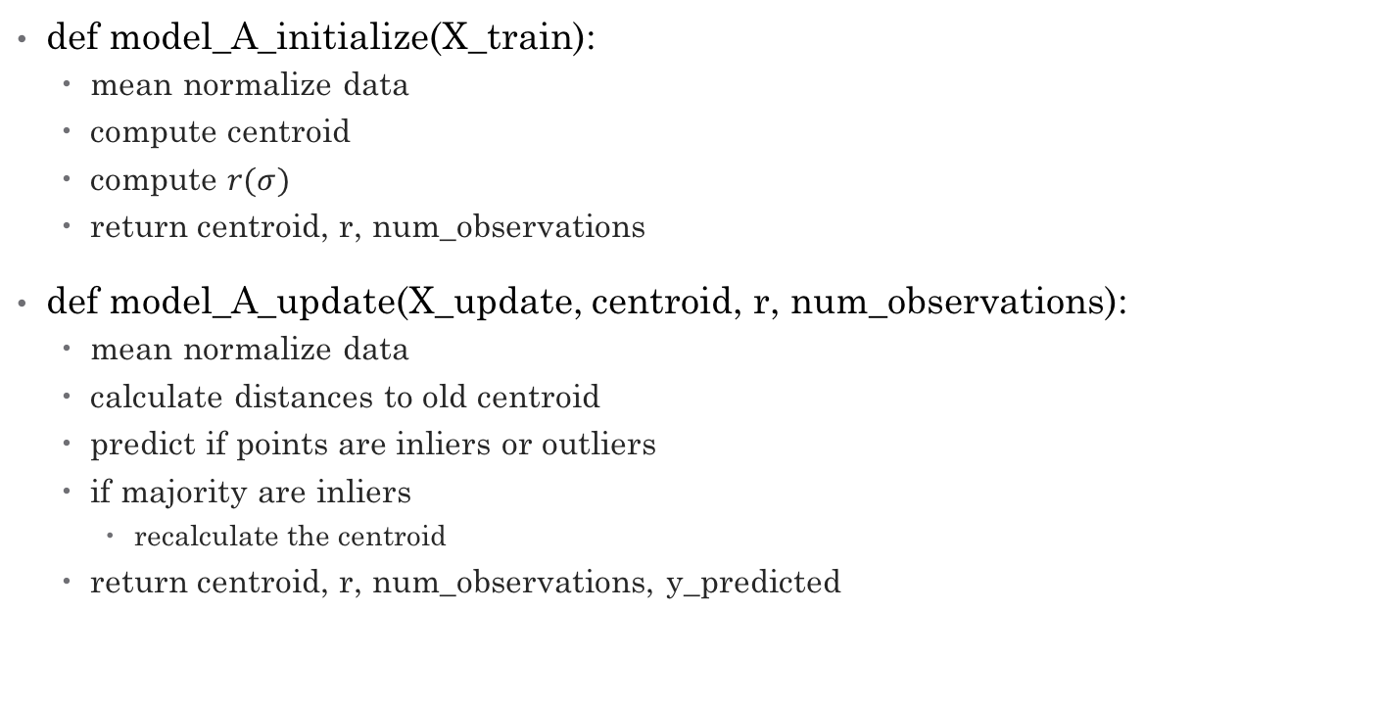
Pseudocode
def model_A_initialize(X_train):
mean normalize data
compute centroid
compute $r(σ)$
return centroid, r, num_observations
def model_A_update(X_update, centroid, r, num_observations):
mean normalize data
calculate distances to old centroid
predict if points are inliers or outliers
if majority are inliers
recalculate the centroid
return centroid, r, num_observations, y_predicted

Slide 6
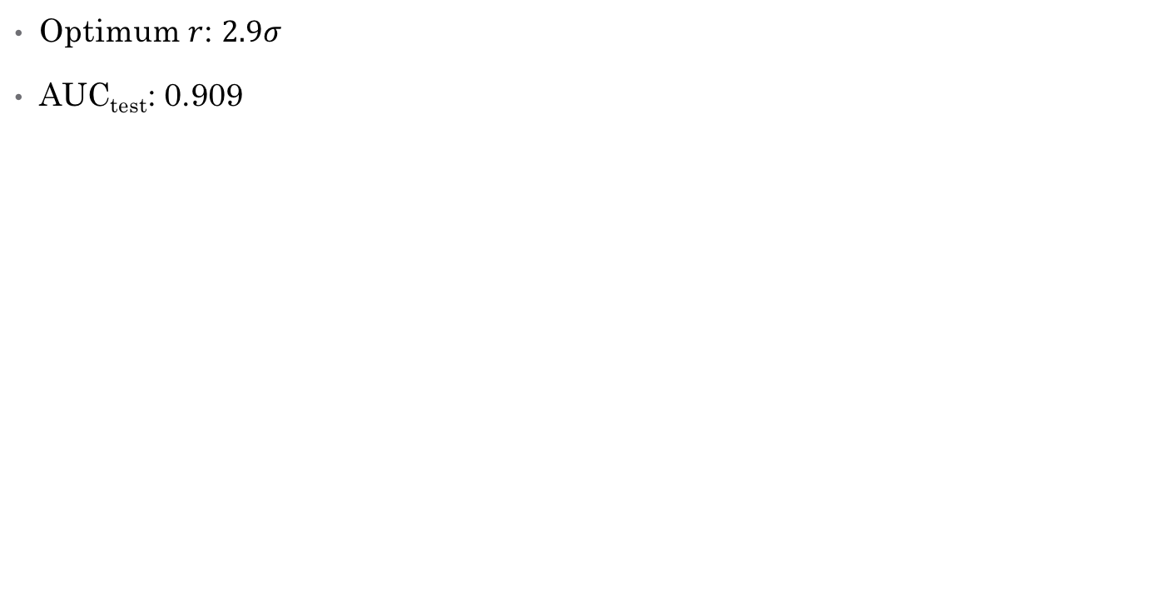
Results
Optimum $r$: $2.9σ$
AUC_{test}: 0.909

Slide 7
Method 2 – One Class SVM
The algorithm is based on Schölkopf B, Williamson RC, Smola AJ, Shawe-Taylor J, Platt JC. Support Vector Method for Novelty Detection. Advances in Neural Information Processing Systems 12, [NIPS Conference, Denver, Colorado, USA, November 29 - December 4, 1999]. 1999. pp. 582–588.
Using scikit learn’s implementation OneClassSVM()

Slide 8
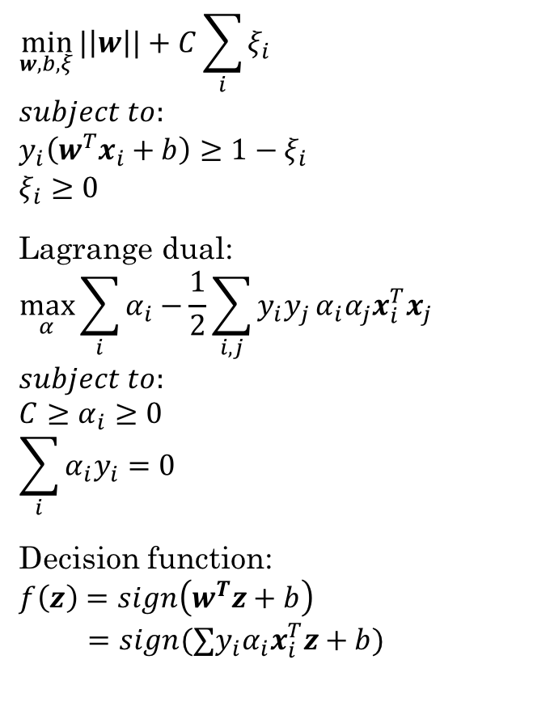
SVM Review
$$\min_{w,b,ξ}{|\left|w\right||}+C\sum_{i}{ξ_{i}}$$
$$subject to:$$
$$y_{i}\left(w^{T}x_{i}+b\right)≥1−ξ_{i}$$
$$ξ_{i}≥0$$
Lagrange dual:
$$\max_{α}{\sum_{i}{α_{i}}−\frac{1}{2}\sum_{i, j}{y_{i}y_{j}}α_{i}α_{j}x_{i}^{T}x_{j}}$$
$$subject to: \\ C≥α_{i}≥0 \\ \sum_{i}{α_{i}y_{i}}=0$$
Decision function:
$$f\left(z\right)=sign\left(w^{T}z+b\right)$$
$$=sign(∑y_{i}α_{i}x_{i}^{T}z+b)$$
source

Slide 9
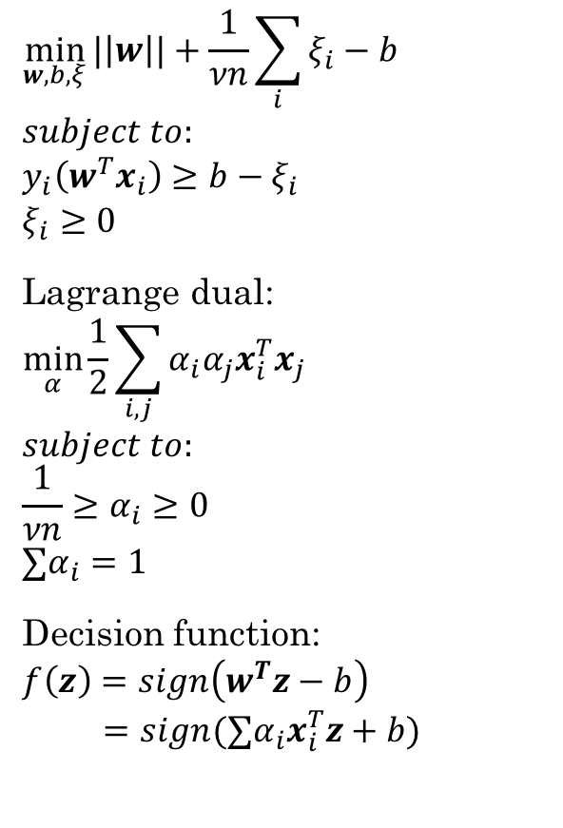
One Class SVM
$$\min_{w,b,ξ}{|\left|w\right||}+\frac{1}{νn}\sum_{i}{ξ_{i}−b}$$
$$subject to:$$
$$y_{i}\left(w^{T}x_{i}\right)≥b−ξ_{i}$$
$$ξ_{i}≥0$$
Lagrange dual:
$$\min_{α}{\frac{1}{2}\sum_{i, j}{α_{i}α_{j}x_{i}^{T}x_{j}}}$$
$$subject to: \\ \frac{1}{νn}≥α_{i}≥0 \\ ∑α_{i}=1$$
Decision function:
$$f\left(z\right)=sign\left(w^{T}z−b\right)$$
$$=sign(∑α_{i}x_{i}^{T}z+b)$$
source

Slide 10
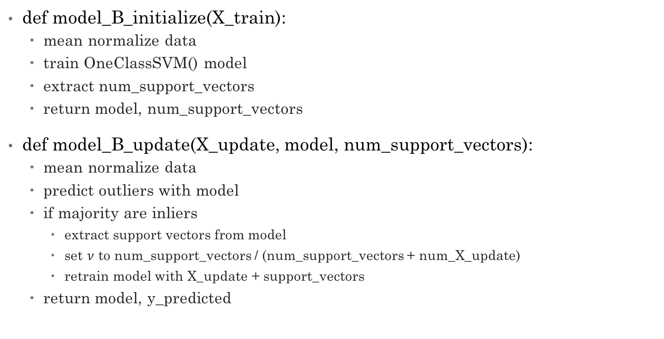
Pseudocode
def model_B_initialize(X_train):
mean normalize data
train OneClassSVM() model
extract num_support_vectors
return model, num_support_vectors
def model_B_update(X_update, model, num_support_vectors):
mean normalize data
predict outliers with model
if majority are inliers
extract support vectors from model
set $ν$ to num_support_vectors / (num_support_vectors + num_X_update)
retrain model with X_update + support_vectors
return model, y_predicted

Slide 11
Results
Validated parameters for initial training: nu = 0.1, kernel = ‘linear’
AUC_{test} = 0.805

Slide 12
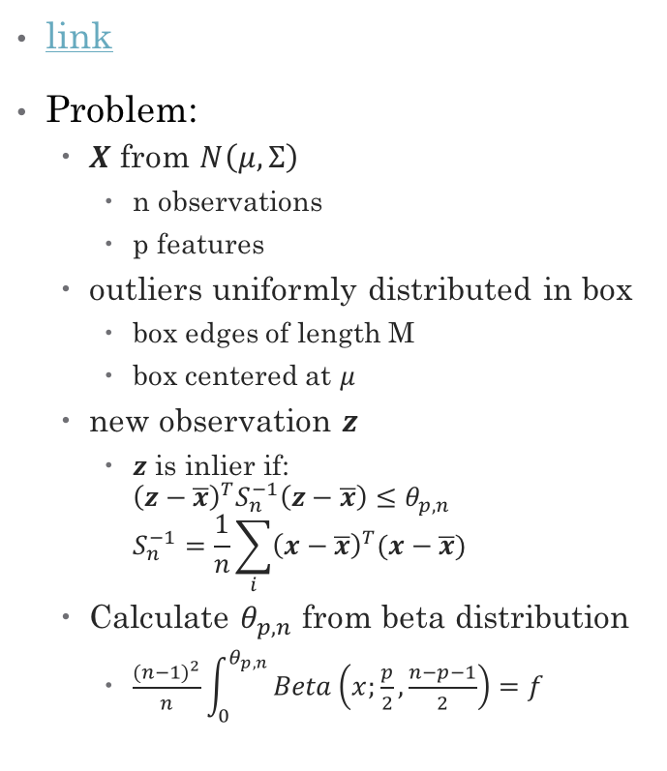
Feature Extraction for One-Class Classification
link
Problem:
$X$ from $N\left(μ, Σ\right)$
n observations
p features
outliers uniformly distributed in box
box edges of length M
box centered at $μ$
new observation $z$
$z$ is inlier if: ${\left(z−\overline{x}\right)}^{T}S_{n}^{−1}\left(z−\overline{x}\right)≤θ_{p,n}$ $S_{n}^{−1}=\frac{1}{n}\sum_{i}{{\left(x−\overline{x}\right)}^{T}(x−\overline{x})}$
Calculate $θ_{p,n}$ from beta distribution
$\frac{{\left(n−1\right)}^{2}}{n}\int_{0}^{θ_{p,n}}{Beta\left(x;\frac{p}{2},\frac{n−p−1}{2}\right)=f}$
source

Slide 13
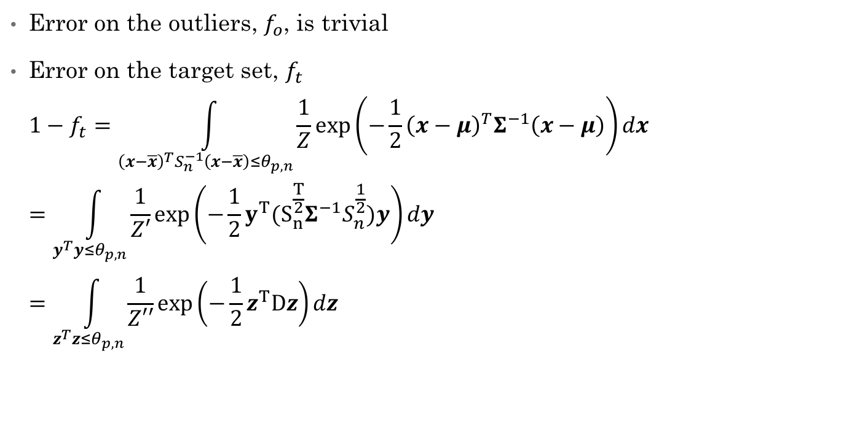
Errors
Error on the outliers, $f_{o}$, is trivial
Error on the target set, $f_{t}$ $1−f_{t}=\int_{{\left(x−\overline{x}\right)}^{T}S_{n}^{−1}\left(x−\overline{x}\right)≤θ_{p,n}}{\frac{1}{Z}}\exp\left(−\frac{1}{2}{\left(x−μ\right)}^{T}Σ^{−1}\left(x−μ\right)\right)dx$ $=\int_{y^{T}y≤θ_{p,n}}{\frac{1}{Z′}}\exp\left(−\frac{1}{2}{y^{T}(S_{n}^{\frac{T}{2}}Σ}^{−1}S_{n}^{\frac{1}{2}})y\right)dy$ $=\int_{z^{T}z≤θ_{p,n}}{\frac{1}{Z′′}}\exp\left(−\frac{1}{2}z^{T}Dz\right)dz$

Slide 14
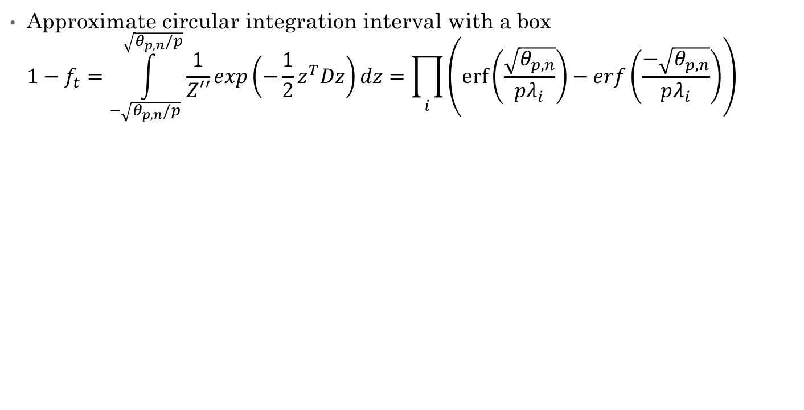
Errors
Approximate circular integration interval with a box $1−f_{t}=\int_{−\sqrt{θ_{p,n}/p}}^{\sqrt{θ_{p,n}/p}}{\frac{1}{Z′′}exp\left(−\frac{1}{2}z^{T}Dz\right)dz}=\prod_{i}{\left(\operatorname{erf}\left(\frac{\sqrt{θ_{p,n}}}{pλ_{i}}\right)−erf\left(\frac{−\sqrt{θ_{p,n}}}{pλ_{i}}\right)\right)}$
E.1
f_{t}
f_{o}
p

Slide 15
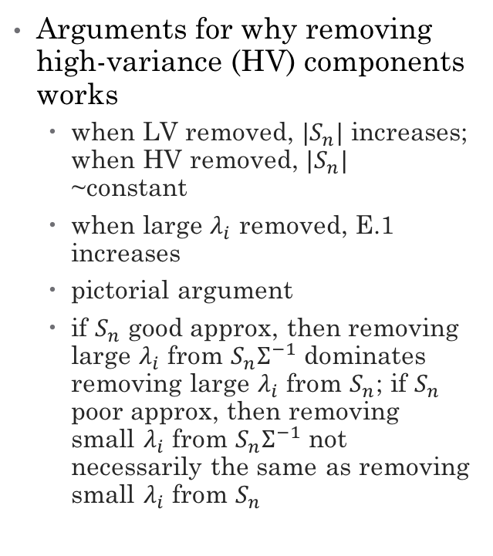
Dimensionality Reduction
Arguments for why removing high-variance (HV) components works
when LV removed, $|S_{n}|$ increases; when HV removed, $|S_{n}|$ ~constant
when large $λ_{i}$ removed, E.1 increases
pictorial argument
if $S_{n}$ good approx, then removing large $λ_{i}$ from $S_{n}Σ^{−1}$ dominates removing large $λ_{i}$ from $S_{n}$; if $S_{n}$ poor approx, then removing small $λ_{i}$ from $S_{n}Σ^{−1}$ not necessarily the same as removing small $λ_{i}$ from $S_{n}$

Slide 16
Tax and Müller Results
Simulated
-calculated f_{o} and f_{t},
but didn’t display
Face dataset:
-19x19 images
-2429 training faces
-472 testing faces
-23573 testing non-faces
Concordia dataset:
-32x32 images
-400 images/class
-”7” is target
-all others outliers

Slide 17
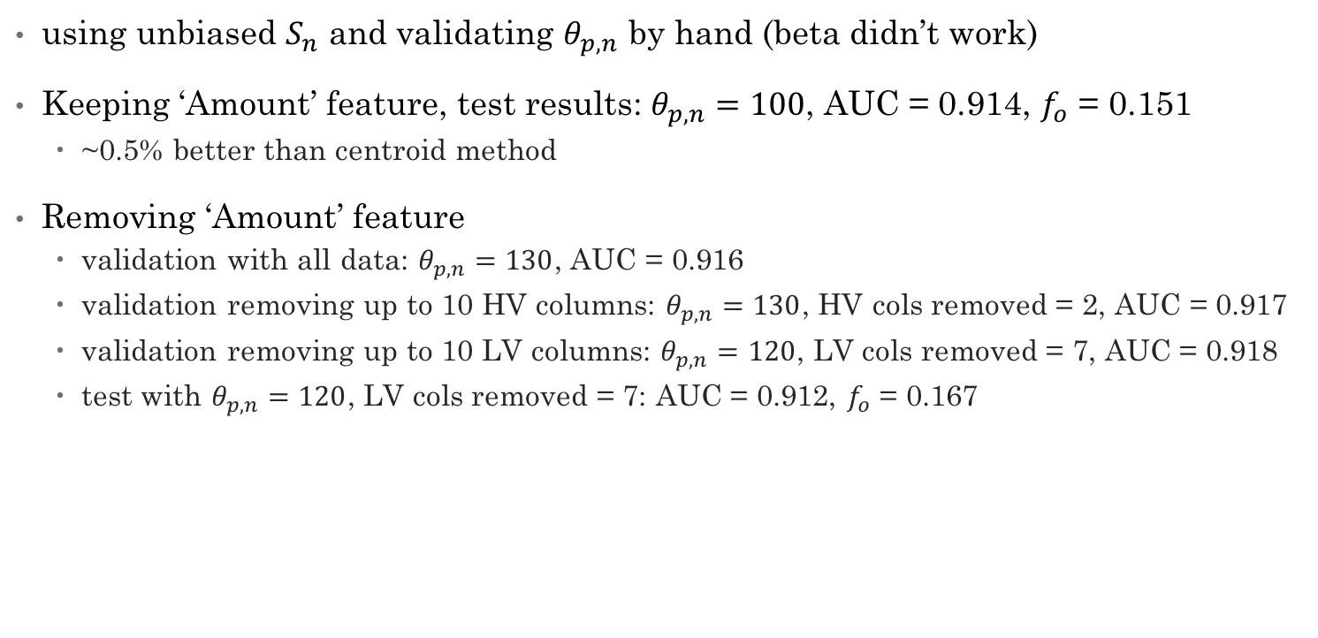
My Results (link)
using unbiased $S_{n}$ and validating $θ_{p,n}$ by hand (beta didn’t work)
Keeping ‘Amount’ feature, test results: $θ_{p,n}=100$, AUC = 0.914, $f_{o}$ = 0.151
~0.5% better than centroid method
Removing ‘Amount’ feature
validation with all data: $θ_{p,n}=130$, AUC = 0.916
validation removing up to 10 HV columns: $θ_{p,n}=130$, HV cols removed = 2, AUC = 0.917
validation removing up to 10 LV columns: $θ_{p,n}=120$, LV cols removed = 7, AUC = 0.918
test with $θ_{p,n}=120$, LV cols removed = 7: AUC = 0.912, $f_{o}$ = 0.167

Slide 18
def model_A_initialize(X_train):
#imports
import pandas as pd
import numpy as np
#mean normalize the input
X_train = (X_train - X_train.mean()) / (X_train.std())
# the centroid should be zero, so I'm hardcoding that to avoid rounding errors
centroid = np.zeros(X_train.shape[1])
# calculate r from data
train_distances = np.linalg.norm(X_train, axis=1) #centroid is zero, so distance is just the norm
multiplier = 2.9 #determined through validation
sigma = train_distances.std() #the standard deviation of the distances
r = multiplier * sigma #the distance threshold for outliers
n = X_train.shape[0]
return centroid, r, n

Slide 19
def model_A_update(X_update, centroid, r, n):
#imports
import pandas as pd
import numpy as np
#make sure X_update is mean normalized
X_update = (X_update - X_update.mean()) / (X_update.std())
# first, see if majority of the points are predicted to be outliers
update_distances = np.linalg.norm(X_update - centroid, axis=1)
y_predicted = np.zeros(X_update.shape[0]) #start with zeros
y_predicted[np.where(update_distances >= r)] = 1 #change to 1's where >= r
frac_outliers = y_predicted.sum() / y_predicted.shape[0] #calculate fraction of outliers
if frac_outliers < 0.5: #if a majority of the points are not outliers
#update the model
for row in X_update.iterrows():
centroid = centroid + (1 / n) * (row[1].values - centroid)
return centroid, r, n, y_predicted

Slide 20
def model_B_initialize(X_train):
#imports
import pandas as pd
from sklearn import svm
#make sure X_train is mean normalized
X_train = (X_train - X_train.mean()) / (X_train.std())
# create model
model = svm.OneClassSVM(nu=0.1, kernel='linear') #hyperparameters found through validation
# fit the model
model.fit(X_train)
#extract the number of support vectors
support_vectors = model.support_vectors_
n_support_vectors = support_vectors.shape[0]
return model, n_support_vectors

Slide 21
def model_B_update(X_update, model, n_support_vectors):
#imports
import pandas as pd
from sklearn import svm
#extract the support vectors
support_vectors = model.support_vectors_
X_update = (X_update - X_update.mean()) / (X_update.std())
#see how many are outliers
y_predict = model.predict(X_update)
# OneClassSVM() outputs 1 for outliers and -1 for normal
y_predict[y_predict==-1] = 0
frac_outliers = y_predict.sum() / y_predict.shape[0]
if frac_outliers < 0.5:
n_new_data = X_update.shape[0]
#combine the support vectors and the new data points
X_new = np.vstack((support_vectors, X_update.values))
#recalculate nu
nu = n_support_vectors / (n_support_vectors + n_new_data)
#fit the new data
model = svm.OneClassSVM(nu=nu, kernel='linear')
model.fit(X_new)
return model, y_predict

Slide 22
Mahalanobis Method
#now low variance first
auc = pd.DataFrame({'theta': [], 'AUC': [], 'LV cols removed': []})
for i in range(1,11):
dict_row = {}
dict_row['LV cols removed'] = i
#create the training subsets and renormalize
X_train_subset = X_train.ix[:,:-i]
X_train_subset = (X_train_subset - X_train_subset.mean()) / (X_train_subset.std())
#recalculate Sn
p = X_train_subset.shape[1]
n = X_train_subset.shape[0]
Sn = 1 / (n - 1) * np.dot(X_train_subset.T, X_train_subset) #mean is zero
Sn_inv = inv(Sn)
#create the validation subsets and renormalize
X_val_subset = X_val.ix[:,:-i]
X_val_subset = (X_val_subset - X_val_subset.mean()) / (X_val_subset.std())

Slide 23
Mahalanobis Method
#continued for loop
#get the distances
val_distances = []
for row in X_val_subset.values:
distance = np.dot(np.dot(row, Sn_inv), row.T)
val_distances.append(distance)
val_distances = np.array(val_distances)
for theta in thetas:
dict_row['theta'] = theta
y_predicted = np.zeros_like(y_val)
y_predicted[np.where(val_distances > theta)] = 1
dict_row['AUC'] = roc_auc_score(y_val, y_predicted)
auc = auc.append(dict_row, ignore_index=True)

